Slide 1
LASSO REGRESSION
In statistics and machine learning, lasso is a regression analysis method that performs both variable selection and regularization in order to enhance the prediction accuracy and interpretability of the resulting statistical model.
Lasso regression is used for eliminating automated variables and the selection of features

Slide 2
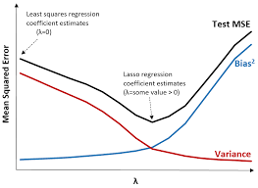
Lasso regression is a type of linear regression that uses shrinkage. Shrinkage is where data values are shrunk towards a central point, like the mean. The lasso procedure encourages simple, sparse models (i.e. models with fewer parameters). ... The acronym “LASSO” stands for Least Absolute Shrinkage and Selection Operator

Slide 3
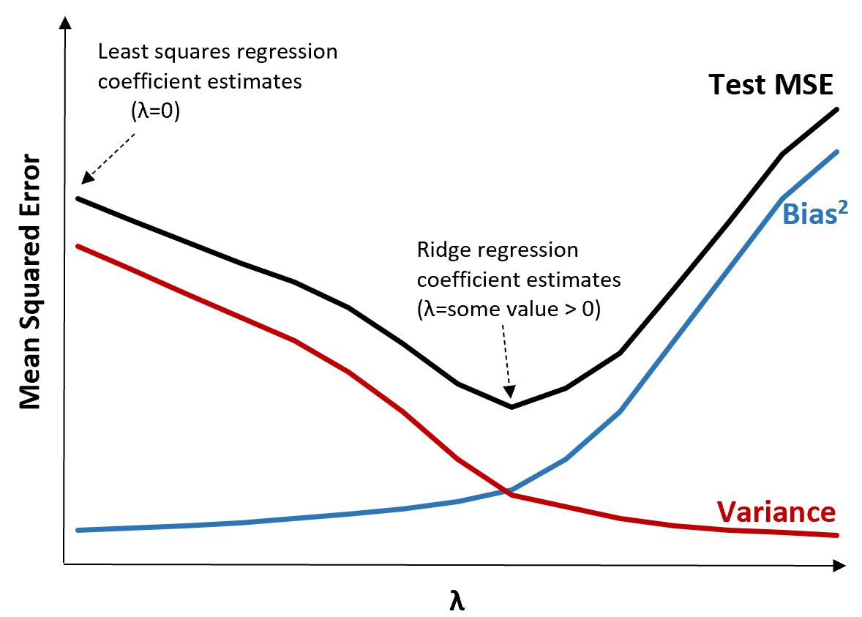
RIDGE REGRESSION
Ridge regression is a method of estimating the coefficients of multiple-regression models in scenarios where independent variables are highly correlated.
Ridge regression is a model tuning method that is used to analyse any data that suffers from multicollinearity. This method performs L2 regularization. When the issue of multicollinearity occurs, least-squares are unbiased, and variances are large, this results in predicted values to be far away from the actual values.

Slide 4

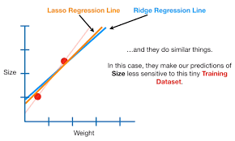
The difference between ridge and lasso regression is that it tends to make coefficients to absolute zero as compared to Ridge which never sets the value of coefficient to absolute zero Y = mX + C + λ(m)^2

Slide 5
X = df2.iloc[:,:].values y = df2.iloc[:,].values
from sklearn.model_selection import train_test_split
X_train,X_test,y_train,y_test = train_test_split(X,y,test_size= 0.2,random_state = 0)
This methodology of lasso and ridge used in linear models by increasing
Tr and decreasing Ts

Slide 6
from sklearn.linear_model import Lasso
model = Lasso(alpha = 0.1,normalize=True)
model.fit(X_train,y_train)
y_pred = model.predict(X_test)
from sklearn.metrics import r2_score
r2_score(y_test,y_pred)

